Slide 1
SS ZG 566 Secure Software Engineering
T V Rao

Slide 2
Web Security Overview RL 9.1

Slide 3
Web Security
Web has two distinct components
Server
Has resources to serve. Content(resources) delivered to the client based on URL etc.
Generally managed by an administrator.
Self-service models reduce control
Client/Browser
The component that is likely to approach a server for content.
Meant for end-user(non-technical)
Security
Need to consider both sides for protecting users

Slide 4
Web Security
During early stages of web, entire security focus was on servers.
Today browsers have acquired lot of capabilities:
JavaScript: Allows a page to execute client-­‐side code.
DOM model Provides a JavaScript interface to the page's HTML, allowing the page to add/remove tags, change their styling, etc.
XMLHttpRequests (AJAX): Asynchronous HTTP requests.
Web sockets: Full-­‐duplex client-­‐server communication over TCP.
Web workers: Multi-­‐threading support.
Multimedia support: (video), web cams, screen-­‐sharing.
Geolocation: Browser can determine your location by examining GPS units. Firefox can also locate you by passing your WiFi information to the Google Location Service.
<canvas> and WebGL: Bitmap manipulation and interactive 2D/3D graphics.
Nacl: Allows browsers to run native code!

Slide 5
Browser Vulnerabilities
Whenever a browser communicates with a website,
the website, as part of that communication, collects some information about the browser (in order to process the formatting of the page to be delivered, if nothing else).
If malicious code has been inserted into the website's content, then vulnerabilities specific to a particular browser can allow this malicious code to run processes within the browser application in unintended ways (one of the bits of information that a website collects from a browser communication is the browser's identity- allowing specific vulnerabilities to be exploited).
Once an attacker is able to run processes on the visitor's machine, then exploiting known security vulnerabilities can allow the attacker to gain privileged access to the victim's machine or network

Slide 6
Securing Web Browser
Web browsers can be breached in one or more of the following ways:
Operating system is breached and malware is reading/modifying the browser memory space in privilege mode
Main browser executable can be hacked
Browser components may be hacked
Browser plugins can be hacked
Browser network communications could be intercepted outside the machine
https://en.wikipedia.org/wiki/Browser_security

Slide 7
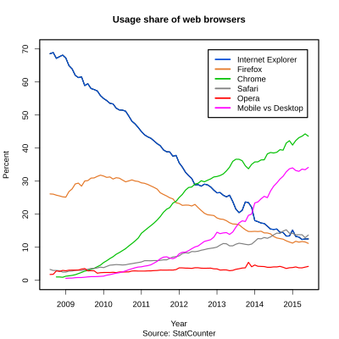
Diversity of Browsers
Complications due to
Presence of multiple browsers
Usage of numerous versions
Most popular browser today is Chrome. As per vulnerability database, in 2017 alone, 8 vulnerabilities have been reported for the browser.
IE has 54 vulnerabilities reported in 2017.
All major browsers seem to have some reported vulnerabilities
Source: https://www.cvedetails.com/index.php

Slide 8
Large Attack Surface
Web has become a complex platform for distributed computation
Developed a Huge Attack Surface
A single web application spans multiple programming languages, Operating Systems, hardware platforms, throwing up emergent vulnerabilities.
E.g. might be running Chrome on Windows interacting with a Linux server running Apache and interfacing with MySQL
Difficult (almost impossible) to verify end-­‐to-­‐end correctness
The web specs are very long, very complex, sometimes contradictory, and constantly evolving (quirks at quirksmode.org and several security information sites)

Slide 9
Anatomy of Web Attack
Typically attacker breaks into a legitimate Web site and posts malware
malware is not exclusive to malicious web sites. Often mainstream web sites are made to act as parasitic hosts that serve up malware to their unsuspecting visitors. Due to the complexity of modern web sites there are several techniques by which they are compromised.
Attacking enduser machines
malware on a web site makes its way down on to a user’s machine when that user visits the host Web site.
Some of the techniques enable this to happen with no user interaction – ‘drive-by-download’.
Some techniques which do require some input from the user.
Leveraging end user machines for malicious activity
The most malicious activities begin once new malware has established a presence on a user’s machine.

Slide 10
Computer Security: Principles and Practice by William Stallings, and Lawrie Brown Pearson, 2008.
www.owasp.com
Matt Bishop, Introduction to Computer Security, Pearson Education, 2005
www.excess-xss.com www.acunetix.com

Slide 11
Thank You!

Slide 12
SS ZG 566 Secure Software Engineering
T V Rao

Slide 13
Cross-site Scripting RL 9.2.1

Slide 14
Cross-site Scripting attack
An XSS attack needs three actors — the website, the victim and the attacker
The attacker injects a payload in the website’s database by submitting a vulnerable form with some malicious JavaScript
The victim requests the web page from the website
The website serves the victim’s browser the page with the attacker’s payload(malicious javascript) as part of the HTML body.
The victim’s browser will execute the malicious script inside the HTML body. In this case it would send the victim’s cookie to the attacker’s server. The attacker now simply needs to extract the victim’s cookie when the HTTP request arrives to the server, after which the attacker can use the victim’s stolen cookie for impersonation.

Slide 15
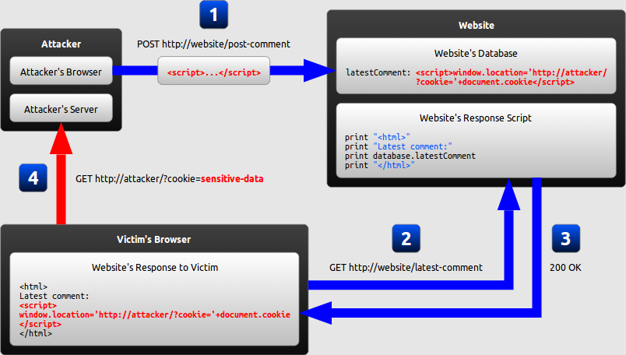
Cross-site Scripting attack
http://www.acunetix.com/websitesecurity/cross-site-scripting/

Slide 16
What’s the worst an attacker can do with JavaScript?
JavaScript has access to the following
Malicious JavaScript has access to all the same objects the rest of the web page has, including access to cookies. Cookies are often used to store session tokens, if an attacker can obtain a user’s session cookie, they can impersonate that user
JavaScript can read and make arbitrary modifications to the browser’s DOM (within the page that JavaScript is running).
JavaScript can use XMLHttpRequest to send HTTP requests with arbitrary content to arbitrary destinations.
JavaScript in modern browsers can leverage HTML5 APIs such as accessing a user’s geolocation, webcam, microphone and even the specific files from the user’s file system. While most of these APIs require user opt-in, XSS in conjunction with some clever social engineering can bring an attacker a long way.

Slide 17
The consequences of malicious JavaScript
Cookie theft:
The attacker can access the victim's cookies associated with the website using document.cookie, send them to his own server, and use them to extract sensitive information like session IDs.
Keylogging:
The attacker can register a keyboard event listener using addEventListener and then send all of the user's keystrokes to his own server, potentially recording sensitive information such as passwords and credit card numbers.
Phishing:
The attacker can insert a fake login form into the page using DOM manipulation, set the form's action attribute to target his own server, and then trick the user into submitting sensitive information.

Slide 18
XSS Examples
The wife of the former prime minister Gordon Brown, who has more than a million followers on Twitter, unknowingly sent a link which contained malicious code that would redirect anyone who moved their mouse over it - but didn't click it - to an evil site.
The problem arises because users are able to post chunks of Javascript program code inside tweets - and because Twitter has not taking precautions to disable the code by "escaping" the relevant characters, the Javascript becomes active.
The specific code being used is onMouseOver, which carries out a function when you move the mouse over the link. Users don't have to click the link to be redirected.
https://www.theguardian.com/technology/blog/2010/sep/21/twitter-bug-malicious-exploit-xss
With a day to go before a critical Pennsylvania Democratic primary, Barack Obama's team has been busy patching security holes.
According to Netcraft, a hacker exploited security flaws in Obama's site to redirect traffic to Hillary Clinton's site. Anyone that visited Obama's community blogs section of the site was sent to Clinton.
http://www.zdnet.com/article/obama-site-hacked-redirected-to-hillary-clinton

Slide 19
Computer Security: Principles and Practice by William Stallings, and Lawrie Brown Pearson, 2008.
www.owasp.com
Matt Bishop, Introduction to Computer Security, Pearson Education, 2005
www.excess-xss.com www.acunetix.com

Slide 20
Thank You!

Slide 21
SS ZG 566 Secure Software Engineering
T V Rao

Slide 22
XSS Variants RL 9.2.2

Slide 23
Variants of XSS
Cross-site scripting vulnerabilities may be of two broad types:
Persistent
Persistent attacks occur when the malicious code is submitted to a web site where it's stored for a period of time. Examples of an attacker's favorite targets often include message board posts, web mail messages, and web chat software. The user is not required to interact with any additional site/link (e.g. an attacker site or a malicious link sent via email), just simply view the web page containing the malicious code.
Non-persistent
Non-persistent attacks (and DOM-based attacks) require a user to either visit a specially crafted link laced with malicious code, or visit a malicious web page containing a web form
They may further be divided into two varieties:
Traditional (caused by server-side code flaws) and
DOM-based (in client-side code)

Slide 24
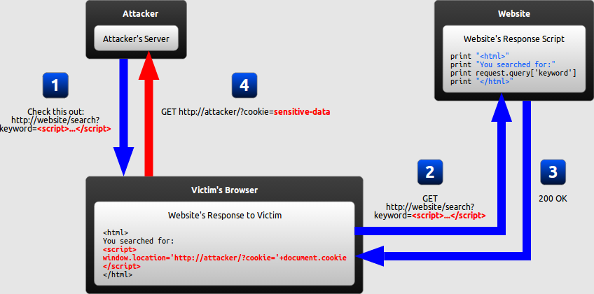
Reflected XSS (non-persistent)
In a reflected XSS attack, the malicious string is part of the victim's request to the website. The website then includes this malicious string in the response sent back to the user
http://excess-xss.com/

Slide 25
Reflected XSS
The attacker crafts a URL containing a malicious string and sends it to the victim.
The victim is tricked by the attacker into requesting the URL from the website.
The website includes the malicious string from the URL in the response.
The victim's browser executes the malicious script inside the response, sending the victim's cookies to the attacker's server.

Slide 26
How can reflected XSS succeed?
Reflected XSS requires the victim to actually send a request containing a malicious string, hence it may seem unlikely attack.
Two common ways of causing a victim to launch a reflected XSS attack against himself
If attacker targets a specific individual, he can send the malicious URL to the victim (using e-mail or instant messaging, for example) and trick him into visiting it.
If the attacker targets a large group of people, he can publish a link to the malicious URL (on his own website or on a social network, for example) and wait for visitors to click it.
With the use of a URL shortening service, which masks the malicious string from users, the chances of successful attack increase.

Slide 27
DOM-based XSS
DOM-based XSS is a variant of both persistent and reflected XSS.
Here the legitimate website does not send attacker’s script
In a DOM-based XSS attack, the malicious string is parsed by the victim's browser after the website's legitimate JavaScript is executed
The legitimate script directly makes use of user input in order to add HTML to the page
Since the malicious string is inserted into the page using innerHTML, it is parsed as HTML, causing the malicious script to be executed
Even with completely secure server-side code, the client-side code might still unsafely include user input in a DOM update after the page has loaded

Slide 28
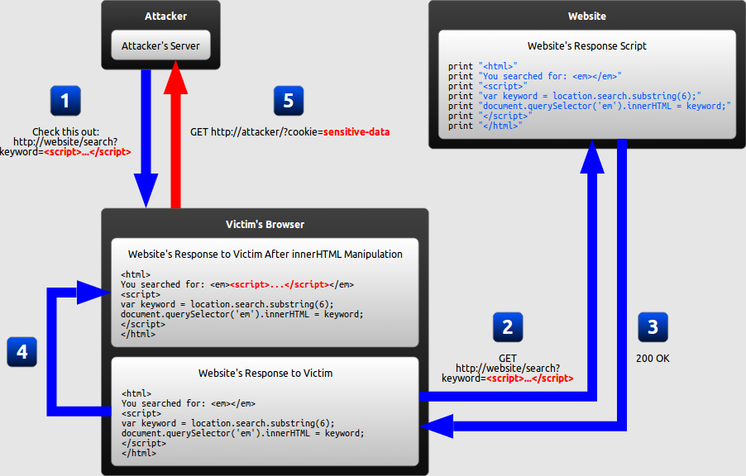
DOM-based XSS

Slide 29
DOM-based XSS Sequence
The attacker crafts a URL containing a malicious string and sends it to the victim.
The victim is tricked by the attacker into requesting the URL from the website.
The website receives the request, but does not include the malicious string in the response.
The victim's browser executes the legitimate script inside the response, causing the malicious script to be inserted into the page.
The victim's browser executes the malicious script inserted into the page, sending the victim's cookies to the attacker's server

Slide 30
Computer Security: Principles and Practice by William Stallings, and Lawrie Brown Pearson, 2008.
www.owasp.com
Matt Bishop, Introduction to Computer Security, Pearson Education, 2005
www.excess-xss.com www.acunetix.com

Slide 31
Thank You!

Slide 32
SS ZG 566 Secure Software Engineering
T V Rao

Slide 33
Cross-Site Request Forgery RL 9.2.3

Slide 34
Cross-Site Request Forgery
Cross-Site Request Forgery (CSRF) is an attack that forces a victim to execute unwanted actions on a web application on which he is currently authenticated.
CSRF attacks specifically target state-changing requests, (no direct theft of data), since the response to the forged request goes to victim.
With social engineering (such as sending a link via email or chat), an attacker may trick the users of a web application into executing actions of the attacker's choosing (including fund transfers etc.)

Slide 35
Cross-Site Request Forgery (CSRF)
Trusted Site
A valid request.
Web
Authenticated Session
User
Browser
Trusted
Action
Web
Trusted Site
Authenticated Session
User
A CSRF attack
Browser
Trusted
Action
Attacking
Site

Slide 36
Common ways to perform a CSRF attack
Common ways to execute CSRF attacks is by using
a HTML image tag,
e.g. IMG SRC <img src="http://host/?command">
or JavaScript image object
e.g. SCRIPT SRC <script src="http://host/?command">

Slide 37
CSRF Attacks
Vulnerability discovered in January 2007 which allowed a attacker to steal a GMail user's contact list.
Discovered in Netflix which allowed an attacker to change the name and address on the account, as well as add movies to the rental queue etc.

Slide 38
Computer Security: Principles and Practice by William Stallings, and Lawrie Brown Pearson, 2008.
www.owasp.com
Matt Bishop, Introduction to Computer Security, Pearson Education, 2005
www.excess-xss.com www.acunetix.com

Slide 39
Thank You!

